Slide 1
“Female Voices from Vedic Times”-
Inspiration from female sages in Sanskrit Epic & Purāṇa Literature
Kuntī, Piṅgalā, Madālasā
World Sanskrit Day Celebrations 2024
Ananda Ashram, NY

Slide 2
“For the love of Sanskrit”...
with special emphasis on Song & the “Sound of Sanskrit”: Listening, chanting, and meaning ...
beautiful and inspiring select Sanskrit verses rendering deep philosophical thoughts. Let us learn from Queen Kuntī about bhakti (devotion) & surrender, from Piṅgalā about freedom from material desires, from Queen Madālasā about the essence of our true nature
may we absorb the wisdom and noble qualities of these female sages and apply them in our everyday lives!

Slide 3
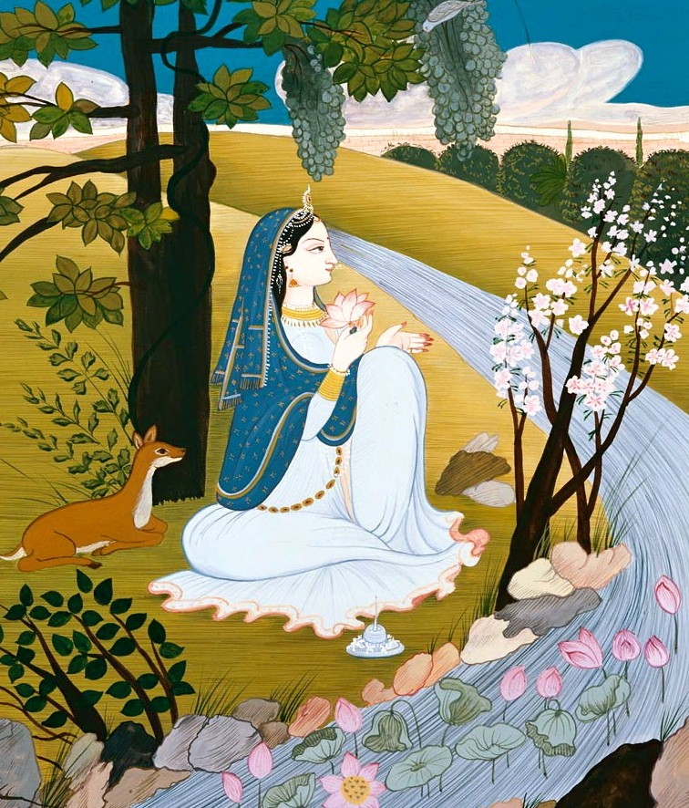
Prayers of Queen Kuntī
Śrīmad-Bhāgavatam (Bhāgavata Purāṇa)
Canto 1, Chapter 8, verses 18-43a
Śrīmatī Kuntī Devī :
Female sage from the Mahābhārata: wife of King Pāṇḍu, mother to the five Pāṇḍavas, aunt to Kṛṣṇa himself. In this ancient and intimate prayer, Queen Kuntī addresses Kṛṣṇa - not as her nephew but as the Supreme Being she has recognised him to be: her beloved Lord. Her words are devotional, pure, sincere, and timeless.

Slide 4
“kuntyuvāca...”
Teachings of Queen Kuntī
Jahnavi Harrison
Composition “Namo Namaḥ” (2021)
https://www.youtube.com/watch?v=eDZx4F0D3BA

Slide 5
Teachings of Queen Kuntī: Reverence
kuntyuvāca
namasye puruṣaṁ tvādyam
īśvaraṁ prakṛteḥ param ।
alakṣyaṁ sarva-bhūtānām
antar bahir avasthitam ॥
kuntī uvāca— Kuntī spoke; namasye—I bow down; puruṣam—the Supreme Person; tvā—You; ādyam—the original; īśvaram—the controller; prakṛteḥ—of the material cosmos; param—beyond; alakṣyam—the invisible; sarva—all; bhūtānām—of living beings; antaḥ—within; bahiḥ—without; avasthitam—existing. Kuntī spoke: O Kṛṣṇa, I offer my obeisances unto You, because You are the original personality and are unaffected by the qualities of the material world. You are existing both within and without everything, yet You are invisible to all. (ŚB 1.8.18)

Slide 6
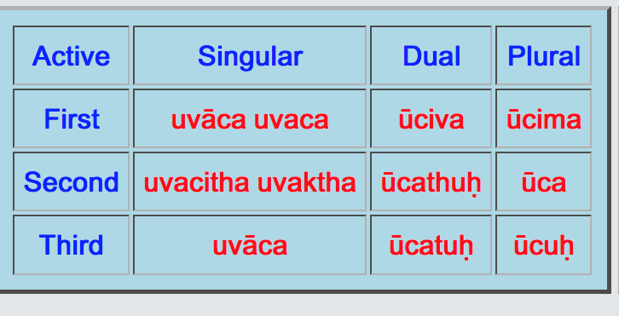
√vac /to speak (2nd conj) uvāca = she spoke (perfect tense)

Slide 7
Teachings of Queen Kuntī:
“Pray for more problems”
vipadaḥ santu tāḥ śaśvat
tatra tatra jagad-guro ।
bhavato darśanaṁ yat syād
apunar bhava-darśanam ॥
vipadaḥ—calamities; santu—let there be; tāḥ—all; śaśvat—again and again; tatra—there; tatra—and there; jagat-guro—O Lord of the universe; bhavataḥ—Your; darśanam—meeting; yat—that which; syāt—may it be; apunaḥ—not again; bhava-darśanam—seeing repetition of birth and death. I wish that all those calamities would happen again and again - so that we could see You again and again. For seeing You means that we will not again see repeated births and deaths. (ŚB 1.8.25)

Slide 8
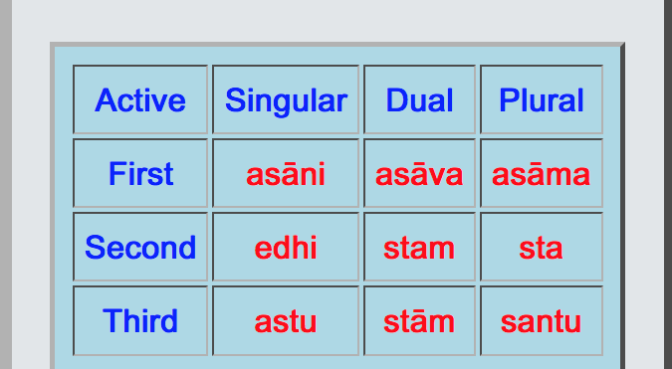
√as, asti /to be (2nd conj, irregular) santu = let there be (imperative mood)

Slide 9
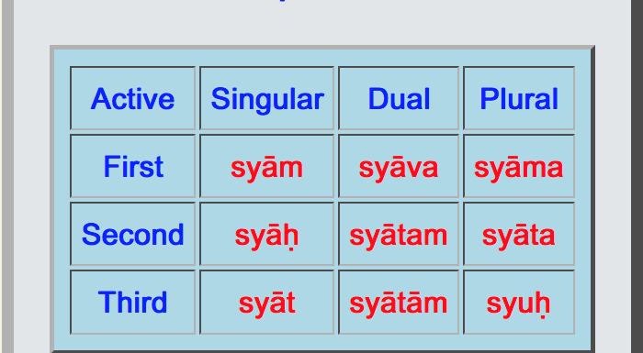
√as, asti/to be (2nd conj, irregular) syāt = may it be (potential mood)

Slide 10
Teachings of Queen Kuntī: Devotion
“Let my heart flow to you always- like a river to the sea”
tvayi me ’nanya-viṣayā
matir madhu-pate ’sakṛt ।
ratim udvahatād addhā
gaṅgevaugham udanvati ॥
tvayi—unto You; me—my; ananya-viṣayā—unalloyed; matiḥ—attention; madhu-pate—O Lord of Madhu; asakṛt—continuously; ratim—attraction; udvahatāt—may overflow; addhā—directly; gaṅgā—the Ganges; iva—like; ogham—a stream; udanvati—in the sea (loc). O Lord of Madhu, as the Ganges forever flows to the sea without hindrance, let my attraction be constantly drawn unto You without being diverted to anything else. (ŚB 1.8.42)

Slide 11
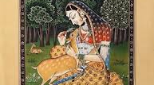
The story of Piṅgalā, the prostitute
(Śrīmad-Bhāgavatam, canto 11, chapter 8, verses 22-44)
“There was once a prostitute named Piṅgalā. One day she (...) was waiting from sunset until midnight for a customer (...) in great anticipation. But as the time passed, her mind became very uneasy. No man came to see her, and in disgust she finally became renounced, giving up her desire for suitors. Thereafter, she engaged herself in thinking only of the Supreme Lord, and her mind achieved peace. The instruction received from her is that hope for sense gratification is the root cause of all suffering. Only one who has given up such desire can truly achieve peace...”
(From: ŚB, Dattatreya - 24 Gurus)

Slide 12
“piṅgalovāca...”
Teachings of Piṅgalā
Karnamrita Dasi
Composition “Piṅgalā” (2004)
Album: Dasi - Prayers by Women
bit.ly/3AGe0d7

Slide 13
piṅgalovāca
aho me moha-vitatiṁ
paśyatāvijitātmanaḥ ।
yā kāntād asataḥ kāmaṁ
kāmaye yena bāliśā ॥
piṅgalā — Piṅgalā; uvāca — said; aho — oh; me — my; moha — of illusion; vitatim — expansion; paśyata — just see, everyone! (2nd pl imperative √dṛś, paśyati/to see) avijita-ātmanaḥ — of one whose mind is not controlled; yā — which person (me); kāntāt — from a lover; asataḥ — useless, insignificant; kāmam — pleasure; kāmaye — I desire; yena — because; bāliśā — I am a fool. Piṅgalā spoke: just see how greatly illusioned I am! Because I cannot control my mind, just like a fool I desire pleasure from an insignificant lover. (ŚB 11.8.30)

Slide 14
santaṁ samīpe ramaṇaṁ rati-pradaṁ
vitta-pradaṁ nityam imaṁ vihāya ।
akāma-daṁ duḥkha-bhayādhi-śoka-
moha-pradaṁ tuccham ahaṁ bhaje ’jñā ॥
santam — being; samīpe — most near (in my heart); ramaṇam — the most dear; rati — actual love or pleasure; pradam — giving; vitta — prosperity; pradam — giving; nityam — eternal; imam — Him; vihāya — giving up; akāma-dam — who can never satisfy one’s desires; duḥkha — misery; bhaya — fear; ādhi — mental distress; śoka — lamentation; moha — illusion; pradam — giving; tuccham — most insignificant; aham — I; bhaje — serve; ajñā — unwise. I have been unwise to have neglected him, who is eternally situated within my heart and most dear to me: the bestower of real love and happiness and the source of all prosperity. Instead, I have ignorantly served insignificant men who can never satisfy my real desires and who have only brought me unhappiness, fear, anxiety, lamentation and illusion. (ŚB 11.8.31)

Slide 15
santuṣṭā śraddhadhatyetad
yathā-lābhena jīvatī ।
viharāmyamunaivāham
ātmanā ramaṇena vai ॥
santuṣṭā — completely satisfied; śraddhadhatī — now having complete faith; etat — in that ; yathā-lābhena — with whatever comes of its own accord; jīvatī — living; viharāmi — I enjoy life; amunā — with that one; eva — only; aham — I; ātmanā — with the Supreme; ramaṇena — who is the real source of love and happiness; vai — indeed. I am now completely satisfied, and I have full faith in that (grace). Therefore I will maintain myself with whatever comes of its own accord. I shall enjoy life with only the Lord, because He is the real source of love and happiness. (ŚB 11.8.40)

Slide 16
āśā hi paramaṁ duḥkhaṁ
nairāśyaṁ paramaṁ sukham ।
yathā sañchidya kāntāśāṁ
sukhaṁ suṣvāpa piṅgalā ॥
āśā — material desire; hi — certainly; paramam — the greatest; duḥkham — unhappiness; nairāśyam — freedom from material desires; paramam — the greatest; sukham — happiness; yathā — in that way; sañchidya — having completely cut off; kānta — for lovers; āśām — the desire; sukham — happily; suṣvāpa — she slept (3rd sg perfect tense of √śvap, śvapati (2nd conjugation)/to sleep; piṅgalā — Piṅgalā. Material desire is undoubtedly the cause of the greatest unhappiness, and freedom from such desire is the cause of the greatest happiness. Therefore, having completely cut off her desire for lovers, Piṅgalā very happily went to sleep. (ŚB 11.8.44)

Slide 17

Queen Madālasā´s Lullaby
(From Madālasā Updeśa, Mārkaṇḍeya Purāṇa, Ch.25-30)
Queen Madālasā is known as one of India’s most ideal and learned women from ancient vedic times. It is considered that she attained enlightenment. Madālasā used to recite this vedantic lullaby to her baby sons when they cried. Due to her direct teachings (she was their main gurvī), three of her four sons gave up the throne and went for penance. A beautiful example of how our mother can be our very first teacher /guru in life ...

Slide 18
“madālasovāca...”
Teachings of Queen Madālasā
Gabriella Burnell (Gaiea)
Composition: “Madālasā” (2018)
(Commissioned by School of Practical Philosophy, Australia)
http://bit.ly/4dvl76Y

Slide 19
Teachings of Queen Madālasā:
Our True Nature
śuddho'si buddho´si nirañjano'si
saṁsāra-māyā-parivarjito'si ।
saṁsāra-svapnaṁ tyaja moha-nidrāṁ
madālasollāpam uvāca putram ॥
“You are forever pure, enlightened, and untainted - untouched by the illusions of Samsara. So give up this dream-world of of Samsara - and wake up from the deep slumber of delusion.” Thus spoke Madālasā to her crying son.

Slide 20
śuddho'si re tāta na te'sti nāma
kṛtaṁ hi te kalpanayādhunaiva।
pañcātmakaṃ deham idaṁ na te'sti
naivāsya tvaṁ rodiṣi kasya heto॥
You are forever pure, you do not have a name. A name is only an imaginary superimposition on you. This body made up of five elements does not belong to you nor you to it.
This being so, what is the reason for your crying?

Slide 21
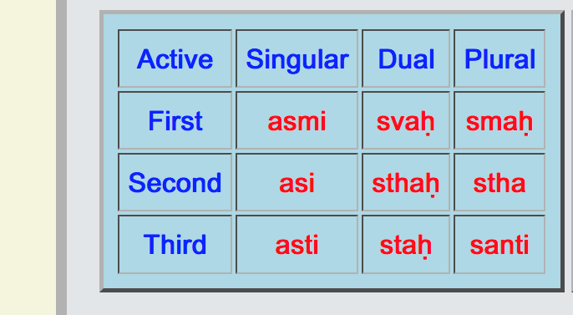
√as/to be (2nd conj, irregular) asi = you are (present tense)

Slide 22
tāteti kiṁcit tanayeti kiṁcit
aṁbeti kiṁciddhayiteti kiṁcit।
mameti kiṁcinna mameti kiṁcit
tvaṁ bhūtasaṁghaṁ bahu mā lapethāḥ ॥
Some may call you father and some may call you son; some may call you mother and some may call you wife. Some say “you are mine” and others “you are not mine”. These are all references to this body (“combination of bhūta/physical elements”), do not identify with them.

Slide 23
śuddho'si buddho´si nirañjano'si
saṁsāra-māyā-parivarjito'si ।
saṁsāra-svapnaṁ tyaja moha-nidrāṁ
madālasollāpam uvāca putram ॥

