Slide 1
Understanding a language
other than mother tongue: Sanskrit
Ananda Ashram World Sanskrit Day celebrations
22nd August to 26th August 2024
Dr MA Jayashree, Mysore

Slide 2
वागर्थाविव सम्प्रुक्तौ वागर्थप्रतिपत्तये
जगतः पितरौ वन्दे पार्वतीपरमेश्वरौ
vāgarthāviva sampṛktau
vāgarthapratipattaye
jagataḥ pitarau vande
pārvatīparameśvarau
I worship Parvati and Parameshwara, the parents of the world, who are inseparable, just like a word and its sense, in order to guide me in acquiring the right understanding of words and their meanings.
Alternate meaning when Parvathi Paramaeshvarau is considered as Parvathipa Rameshvaru: Kalidasa is praying to Lord Shiva and Lord Vishnu who are ‘Pitarau’ (fathers) to this Jagath who are inseparable like the word and the meaning.

Slide 3
This verse is a tribute to the great ancient Sanskrit grammarian Pāṇini, who is credited with the composition of the "Aṣṭādhyāyī," a comprehensive and systematic treatise on Sanskrit grammar. This verse praises Pāṇini for his work, which is said to be based on the sacred sounds or phonemes that he received from Lord Shiva.
The Verse:
येनाक्षरसमाम्नायमधिगम्य महेश्वरात् |
कृत्स्नं व्याकरणं प्रोक्तं तस्मै पाणिनये नमः ||
Transliteration:
Yenākṣarasamāmnāyam adhigamya Maheśvarāt |
Kṛtsnaṁ vyākaraṇaṁ proktaṁ tasmai Pāṇinaye namaḥ ||
Translation:
"By whom the complete system of grammar was taught, after receiving the sacred phonemes from Lord Maheshvara (Shiva),
To that Pāṇini, I bow down.“

Slide 4
This verse is a tribute to Pāṇini, the ancient Sanskrit grammarian known for his work "Aṣṭādhyāyī," which is a foundational text in the study of Sanskrit grammar.
Here's the verse:
येन धौता गिरः पुंसाम् विमलैः शब्दवारिभिः।
तमश्चाज्ञानजं भिन्नं तस्मै पाणिनये नमः॥
Transliteration:
yena dhautā giraḥ puṁsām vimalaiḥ śabdavāribhiḥ |
tamaśca ajñānajaṁ bhinnaṁ tasmai Pāṇinaye namaḥ ||
Translation:
" My salutation to that Panini by whom the speech of human beings has been cleansed with the pure waters of words,
And by whom the darkness born of ignorance has been shattered.“

Slide 5
This verse is a popular Sanskrit śloka that honours three great ancient scholars of Sanskrit grammar: Vararuci, Patañjali, and Pāṇini. This śloka is often recited by students and scholars of Sanskrit grammar and linguistics as a mark of respect to these sages.
The Verse:
वाक्यकारं वररुचिं भाष्यकारं पतञ्जलिम् |
पाणिनिं सूत्रकारं च प्रणमामि मुनित्रयम् ||
Transliteration:
Vākyakāraṁ Vararuciṁ Bhāṣyakāraṁ Patañjalim |
Pāṇiniṁ Sūtrakāraṁ ca Praṇamāmi Munitrayam ||
Translation:
"I bow to the trio of sages:
Vararuci, the author of the Vākya (sentences),
Patañjali, the author of the Bhāṣya (commentary),
and Pāṇini, the author of the Sūtras (aphorisms).“

Slide 6
Panini is known for his text Ashtadhyayi, a sutra-style treatise on Sanskrit grammar, 3,959 "verses" or rules on linguistics, syntax and semantics in "eight chapters" which is the foundational text of the Vyakaran branch of the Vedang, the auxiliary scholarly disciplines of the Vedic period. His aphoristic text attracted numerous bhashya (commentaries), of which Patanjali's Mahabhashya is the most famous in Hindu traditions. His ideas influenced and attracted commentaries from scholars of other Indian religions such as Buddhism.Each verse consists of a group of basic Sanskrit phonemes (i.e. open syllables consisting either of initial vowels or consonants followed by the basic vowel "a") followed by a single 'dummy letter', or anubandha, conventionally rendered in upper case and named 'IT' by Pāṇini.
The Śiva·sūtras, technically akṣara·samāmnāya, variously called māheśvarāṇisūtrāṇi, pratyāhāra·sūtrāṇi, varṇa·samāmnāya, etc., refer to a set of fourteen aphorisms devised as an arrangement of the sounds of Sanskrit for the purposes of grammatical exposition as carried out by the grammarian Pāṇini in the Aṣṭādhyāyī.^{[1][2]}
Pāṇini himself uses the term akṣara·samāmnāya whereas the colloquial term "Shiva sutra" is a later development, as per claims by Nandikeśvara in his Kāśikā, that the god Śiva sounded his drum fourteen times to reveal these sounds to Pāṇini. They were either^{[a]} composed by Pāṇini to accompany his Aṣṭādhyāyī or predate him.^{[1][2][3]}

Slide 7
All languages are sounds. A combination of variety of basic sounds make a word, a group of words make a sentence and so on. When it comes to understanding a language, the child learns it’s mother tongue from even before it’s birth. It listens to the mother. But when we want to learn a second language the very important steps are listening & speaking.

Slide 8
How do I understand a language?
Understanding a language involves several key steps, which can be approached in various ways depending on your goals, current level, and the language itself. We need to know the
Basic Vocabulary and Phrases
2. Grammar Basics
Understand Sentence Structure: Learn how sentences are constructed, including subject-verb-object order.
Key Grammar Rules: Focus on fundamental grammar rules such as the cases of nouns (prepositions in english),
verb conjugation, tense, person, number and gender agreement.
3. Listening and Speaking
Listen to speakers of different languages to get used to it’s pronunciation and rhythm. Then practice speaking:

Slide 9
Understanding sanskrit
Sanskrit is an ancient language of India. It has a rich literary and philosophical tradition.
Phonetics and Pronunciation: Sanskrit has a well-organized phonetic system with distinct vowels, consonants, and their respective nasal and aspirated forms. Its pronunciation rules are precise, making it a suitable language for chanting and mantras.
Grammar and Syntax: Sanskrit grammar is highly systematic and is based on the rules laid down by the ancient grammarian Pāṇini in his work, the Aṣṭādhyāyī. It uses inflection to indicate relationships between words in a sentence, meaning that word order is flexible compared to many modern languages.
Literature: Sanskrit has an extensive literature, like Vedas, Upanishads, epics Mahābhārata and Rāmāyaṇa, philosophical texts and a vast array of poetry, drama, and scientific treatises.

Slide 10
The Śiva·sūtras, technically akṣara·samāmnāya, variously called māheśvarāṇi sūtrāṇi, pratyāhāra·sūtrāṇi, varṇa·samāmnāya, etc.
It is said , that the god Śiva sounded his drum fourteen times to reveal these sounds to Pāṇini.
a i u Ṇ
ṛ ḷ K
e o Ṅ
ai au C
ha ya va ra Ṭ
la Ṇ
ña ma ṅa ṇa na M
jha bha Ñ
gha ḍha dha Ṣ
ja ba ga ḍa da Ś
kha pha cha ṭha tha ca ṭa ta V
ka pa Y
śa ṣa sa R
ha L

Slide 11
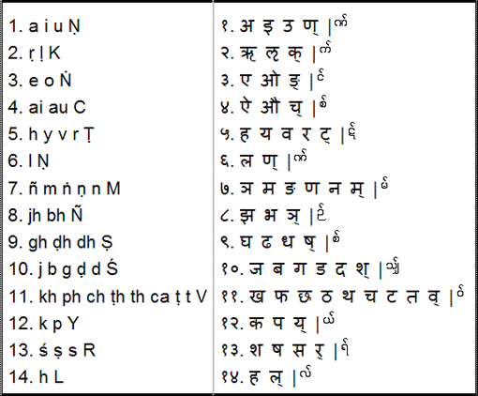
The Śiva·sūtras, technically akṣara·samāmnāya, variously called māheśvarāṇi sūtrāṇi, pratyāhāra·sūtrāṇi, varṇa·samāmnāya, etc.

Slide 12
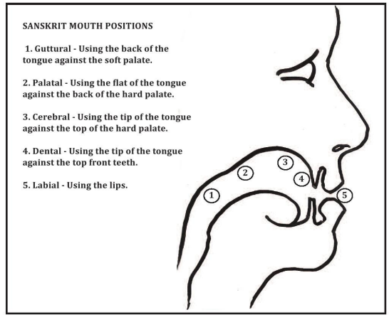

Slide 13
Most Sanskrit sounds are pronounced with five places of articulation within the mouth. You can see these five points marked in the image below:
How the Shiva Sutras work Each rule in this list has two parts. The black letters are ordinary sounds. And the red letters at the end of each rule are special letters called its.
These ‘it’ letters are not part of our list of sounds. Instead, they just mark the end of each rule. Suppose that we want to refer to all of the vowels. We start by choosing the first item we want, which is a. Then we choose one of the ‘it’ letters to mark the end of our list. So we would choose c, since c follows the last vowel in the list. The combination of these two is ac. So that is the name for all of the Sanskrit vowels: ‘ac’.
Likewise, we can quickly refer to other groups of sounds: ’al’ all letters, ‘hal’ all consonants .

Slide 14
What's 5wh
The term "5W1H" stands for Who, What, When, Where, Why, and How. These are the fundamental questions used in information gathering, problem-solving, and reporting. Here's what each represents:
Who: the subject, Identifies the person or group involved.
What: the object, Describes the event or situation.
When: time, Specifies the time or timing of the event.
Where: space, Indicates the location.
Why: the purpose, Explains the reason or cause.
How: the instrument or the tool, Describes the method or process.
This approach is commonly used in journalism, research, and various analytical fields to ensure comprehension of languages.

Slide 15
The phrase "यत् क्रियान्वयी तत् कारकम्" is a fundamental principle in the study of Sanskrit grammar, particularly in the context of Pāṇini's grammar system, the Aṣṭādhyāyī.
Breakdown of the Phrase:
यत् (yat): "That which"
क्रियान्वयी (kriyānvayī): "Dependent on or associated with an action (verb)"
तत् (tat): "That"
कारकम् (kārakam): "Kāraka" or "agent/participant" in the action, generally translated as "case" or "grammatical relation."
Translation:
"That which is associated with or dependent on an action (verb) is called a 'Kāraka'."

Slide 16
kāraka The Pāṇinian school assumes that sentences have a basic structure. There is a verb, like dadAti (gives) that describes some action and decides the meaning of the sentence. And there are different components involved in this action:
The key word in a sentence is the verb. Verb denotes the tense, person & number. When we take the verb and ask questions on it, which are called sapta ka-kArAH, the answers are the six cases called vibhakti-s in sanskrit.

Slide 17
The idea is that the roles that nouns or pronouns play in relation to a verb are described as "Kārakas".
Types of Kārakas:
Pāṇini identifies six primary Kārakas:
कर्तृ (Kartr): The doer or agent (Subject).
कर्म (Karma): The object or what is being acted upon.
करण (Karaṇa): The instrument or means by which the action is performed.
संप्रदान (Sampradāna): The recipient or beneficiary of the action.
अपादान (Apādāna): The point of origin or separation.
अधिकरण (Adhikaraṇa): The location or context within which the action occurs.
Example:
Consider the sentence rāmaḥ phalam dadāti ( rama gives a fruit)
Rāmaḥ: The doer (agent) of the action, hence Kartr.
phalaṁ: The object, hence Karma.
Here, the roles of "Rama" and “fruit" in relation to the action “gives" are described as Kārakas.

Slide 18
We can see the same arrangement in kAraka which is given by Maharshi pANini around 2300 years ago.
What is a karaka in sanskrit?
In Sanskrit, the term "Karaka" (कारक) refers to a grammatical category that denotes the relation between a verb and its participants in a sentence. Specifically, "Karaka" relates to the different roles that words play in the context of the verb's action, such as
kaH? Who? the kartr, the subject,
Kim? What/whom ? karma the object,
Katham? How? karaNa the instrument,
Kimartham? Why? the purpose the sampradAna,
kutaH? from where the apAdAna, and
Kutra/ kadA? Where/when? “adhikaraNa (location ie; where & when).,
Sanskrit grammar categorizes these roles to help understand how each word in a sentence contributes to the overall meaning.
The concept of Karaka is a crucial aspect of Sanskrit syntax and helps in the analysis and construction of sentences, ensuring clarity in communication and meaning.

Slide 19
Since Sanskrit is an inflectional language, the nouns will change their root form in to 24 forms, as every noun has three components, gender, number & case.
There are three linga or genders, masculine (pum), feminine (strI) & neuter ( napum).
There are 3 vacanas or numbers, singular (eka), dual (dvi)& plural (bahu).
There are 7 + 1 cases or vibhakti-s , making each noun into 24 forms.
The noun forms can be easily identified with the last part of the word which shows the meaning of that word. In English the meaning is obtained by the pre-positions which are separately used behind the noun. Hence the ord order or syntax is not essential in sanskrit.

Slide 20
Let us take a verb dadaati (gives).
kah dadaati ? Who gives?
bAlaH dadaati . A boy gives.
The answer is the subject or nominative case, prathamA vibhaktiH
Kim dadAti? What does he give?
bAlaH phalam dadAti. boy gives a fruit.
Katham dadAti ? How does he give?
Hastena dadAti. With his hand.
Kasmai/ Kimartham dadAti ? Why/to whom does he give?
mitrAya/ArogyAya dadAti. To his friend /For good health).
kutaH dadAti? From where does he give?
vrkShAt dadAti. From the tree.
Kutra dadAti? Where does he give?
Vane dadAti. In the forest.
The complete sentence with all thecomponents will be
bAlaH phalam Hastena mitrAya (ArogyAya) vrkShAt Vane dadaati
The different components of some action are called kārakas. Roughly, you can think of a kāraka as an intermediate idea between the meaning we want to ex‐ press.

Slide 21
In Sanskrit, nouns are declined according to gender, number, and case. Sanskrit has three genders (masculine, feminine, and neuter), three numbers (singular, dual, and plural), and eight cases (nominative, accusative, instrumental, dative, ablative, genitive, locative, and vocative).
Let's go through the declension of a masculine noun ending in "-a," using the word "deva" (देव), which means "god.“ let us take only a word in masculine, ending in sound ‘a’ in Singular (Eka-vachana) only
Nominative (Subject): देवः (devaḥ) - "the god“ (no preposition)
Accusative (Object): देवं (devam) - "the god" (as an object-no preposition)
Instrumental (By/With): देवेन (devena) - "by/with the god"
Dative (To/For): देवाय (devāya) - "to/for the god"
Ablative (From): देवात् (devāt) - "from the god"
Genitive (Of): देवस्य (devasya) - "of the god"
Locative (In/On/At): देवे (deve) - "in/on/at the god"
Vocative (O!): देव (deva) - "O god!“
Other nouns will have different endings and slightly different patterns.

Slide 22
Sentences Because Sanskrit words are highly inflected, Sanskrit does not usually depend on a specific word order. For example, the two sentences below have the same se‐ mantics:
rāmo rāvaṇaṃ hanti
Rama kills Ravana.
rāvaṇaṃ rāmo hanti
Rama kills Ravana.
Since word order is relatively unimportant in Sanskrit, the Aṣṭādhyāyī focuses in‐ stead on a fourth question: how do words with different semantics combine to ex‐ press sentence-level semantics?

Slide 23
Declension of "देव" (Masculine)
Case Sing (Eka) Dual (Dvi) Plural (Bahu)
Nominative
देवः (devaḥ) देवौ (devau) देवाः (devāḥ)
Accusative
देवम् (devam) देवौ (devau) देवान् (devān)
Instrumental
देवेन (devena) देवाभ्याम् (devābhyām) देवैः (devaiḥ)
Dative
देवाय (devāya) देवाभ्याम् (devābhyām) देवेभ्यः (devebhyaḥ)
Ablative
देवात् (devāt) देवाभ्याम् (devābhyām) देवेभ्यः (devebhyaḥ)
Genitive
देवस्य (devasya) देवयोः (devayoḥ) देवानाम् (devānām)
Locative
देवे (deve) देवयोः (devayoḥ) देवेषु (deveṣu)
Vocative
हे देव (he deva) हे देवौ (he devau) हे देवाः (he devāḥ)

Slide 24
Declension of "देव" (Masculine)
Case- vibhakti. Sing (Eka) Dual (Dvi) Plural (Bahu)
Nominative – prathamA – kartr – subject (no preposition)
देवः (devaḥ) देवौ (devau) देवाः (devāḥ)
Accusative – dvitIyA – karma – object (no preposition)
देवम् (devam) देवौ (devau) देवान् (devān)
Instrumental - trtIyA – karaNa – instrument (by/with)
देवेन (devena) देवाभ्याम् (devābhyām) देवैः (devaiḥ)
Dative – caturthI – sampradAnam – action og giving (to/for)
देवाय (devāya) देवाभ्याम् (devābhyām) देवेभ्यः (devebhyaḥ)
Ablative – pancamI – apAdAnam – action of separation (from/ because of)
देवात् (devāt) देवाभ्याम् (devābhyām) देवेभ्यः (devebhyaḥ)
Genitive – ShaShThI – sambandhah ( not a kAraka)
देवस्य (devasya) देवयोः (devayoḥ) देवानाम् (devānām)
Locative – saptamI – adhikaraNam – location (in/on/at)
देवे (deve) देवयोः (devayoḥ) देवेषु (deveṣu)
Vocative – sambodhana prathamA – directly address
हे देव (he deva) हे देवौ (he devau) हे देवाः (he devāḥ)

Slide 25
In Sanskrit, the verb "पठ्" (paṭh), which means "to read" or "to recite," is conjugated according to the person, number, and tense. Here’s how it conjugates in the present tense:
Present Tense (लट् लकारः)
Singular (eka) dual (dvi) plural (bahu)
Third Person
(सः/सा/तत् – he/she/it): तौ/ते/ते): (ते/ता/तानि - they):
पठति (paṭhati) (पठतः paṭhataḥ) पठन्ति (paṭhanti)
He/she/it reads they both read they read
Second Person
त्वम् – tvam - you: युवाम् – yuvAm – you two: यूयम् - yUyam – you all
पठसि (paṭhasi) पठथः (paṭhathaḥ) पठथ (paṭhatha)
You read you both read you all read
First Person
(अहम् – aham - I): (आवाम् – AvAm – we both)): (वयम् – vayam - we):
पठामि (paṭhāmi) पठावः (paṭhāvaḥ) पठामः (paṭhāmaḥ)
I read we both read we read

Slide 26
Summary of Endings for First Conjugation (Class I)
Person Singular Dual Plural
3rd- ति (ati)- तः (ataḥ)- न्ति (anti)
2nd- सि (asi)- थः (athaḥ)- थ (atha)
1st- मि (āmi)- वः (āvaḥ)- मः (āmaḥ)
These are the basic conjugations in the present tense for Sanskrit verbs. The pattern can vary slightly depending on the specific verb class and root, but this structure provides a solid foundation for understanding Sanskrit verb conjugation in the present tense.

Slide 27
Song 2.
rAmah. likhati a A i I
kr.SNah. likhati u U r. lr.
bAlA likhati E ai O au
am. ah. likhati gOpInAthah.
kA tvam. bAlE? kAn*canamAlA
kasyAh. putrI? kanakalatAyAh.
hastE kim tE? tAlIpatam.
kA vA rEkhA? ka kha ga gha
kstvam. bAla? mOhanakr.SNah.
kasyAh. putrO? hEmalatAyAh.
hastE kim tat? lEkhanaphalakam.
kim. tallikhitam.? ca cha ja jha

Slide 28
kA tvam. bAlE? snEhalatAham.
kasyAh. putrI? hamsalatAyAh.
hastE kim tat? lEkhanapatram.
kim. vA likhasi? Ta Tha Da Dha
kAstvam. bAla? dInadayAluh.
kO vA janakO? rAmakishOrah.
hastE kim tE? pustakamEva
kim vA paThasi? ta tha da dha
kA sA bAlA? prEmalatA sA
kasyAh. putrO? kalpalatAyAh.
hastE kim vA? lekhanapatram.
kim. vA vadati? pa pha ba bha
shrIshah. likhati ya ra la va
mAlA paTati sha Sa sa ha
sarvO likhati n.a ma n*a Na na miti
dEvah. nandati dr.STvA sarvam.

Slide 29
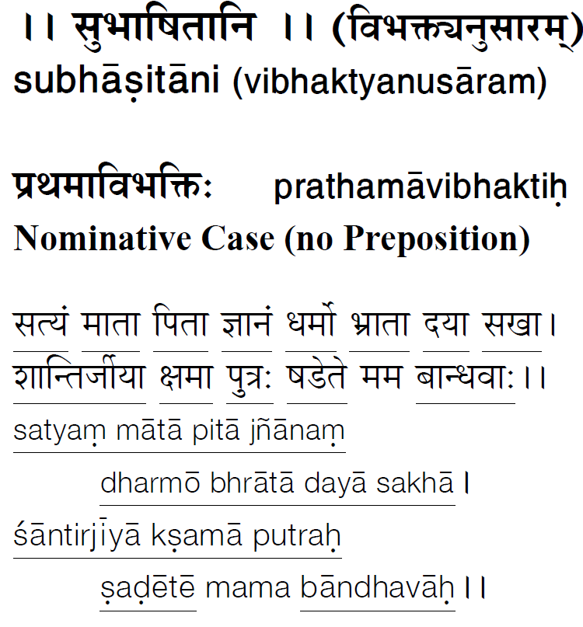
All the underlined words are in that particular vibhakti (case)

Slide 30
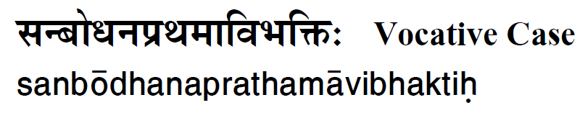
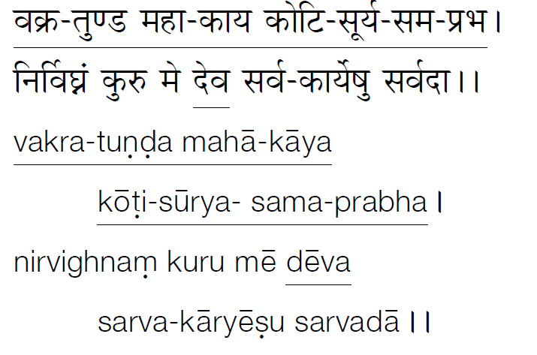

Slide 31
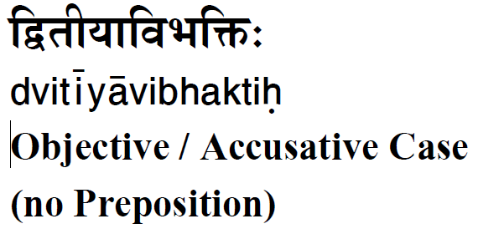
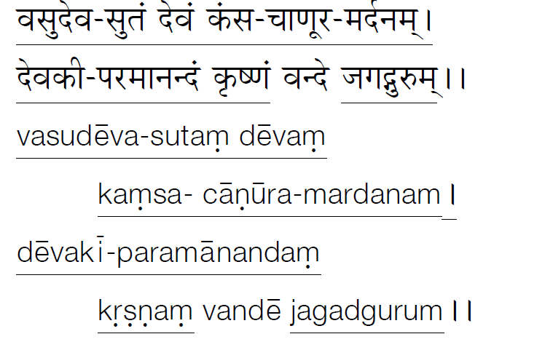

Slide 32
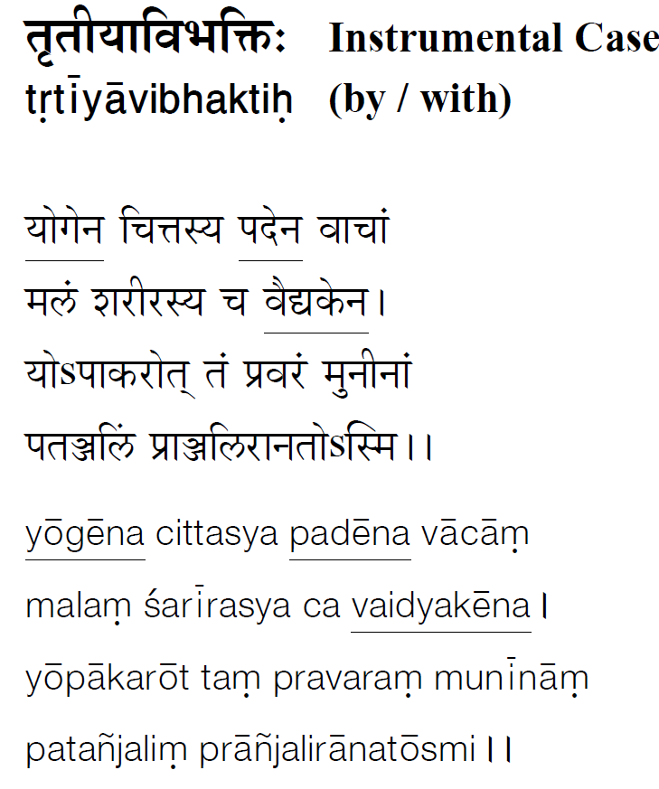

Slide 33
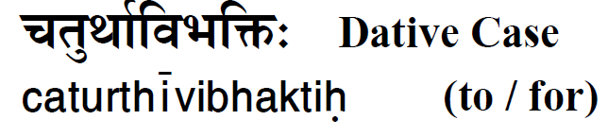
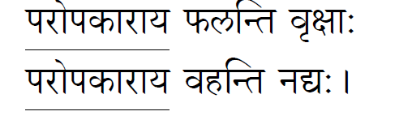
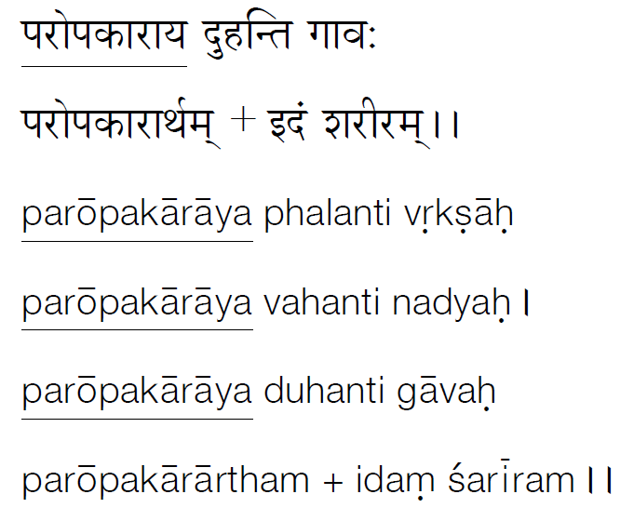

Slide 34
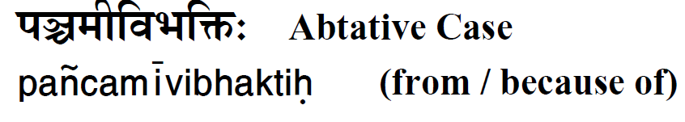
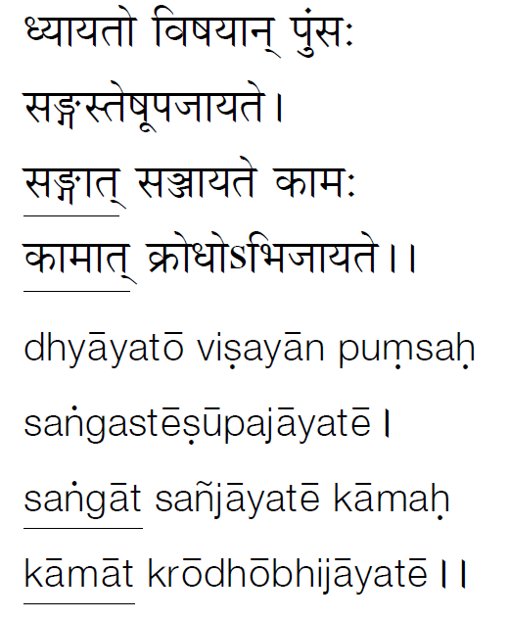

Slide 35
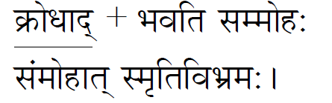
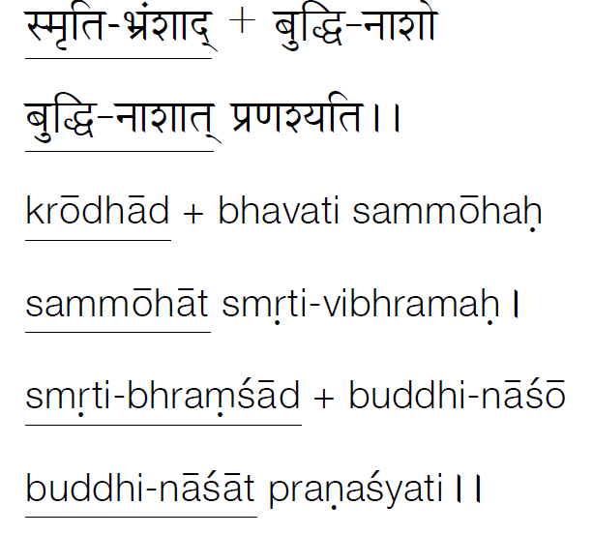

Slide 36
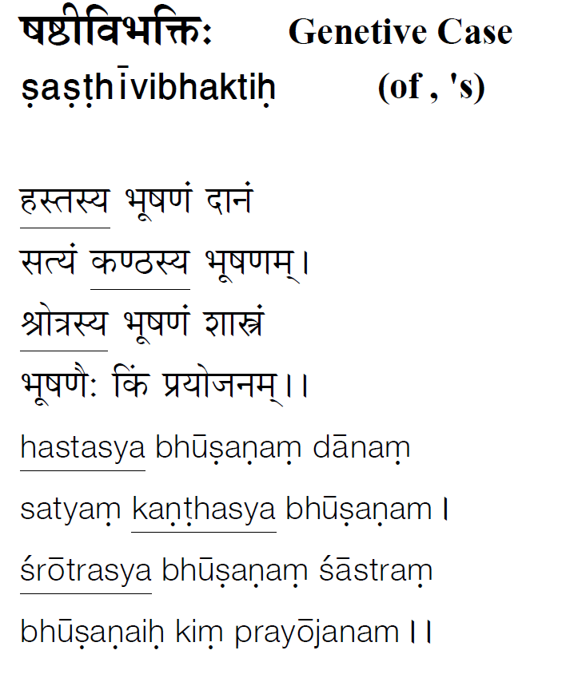

Slide 37
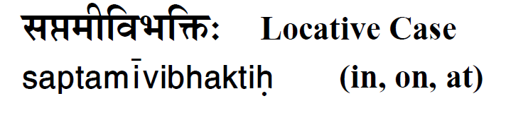
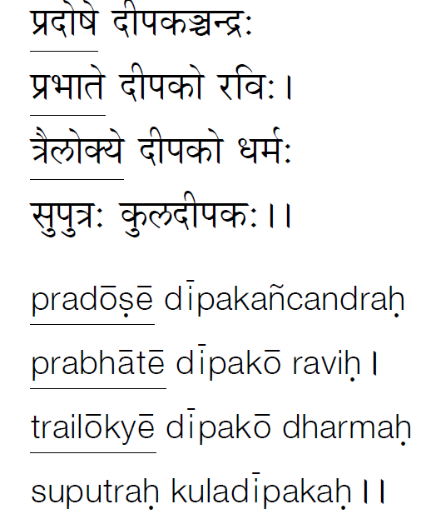

Slide 38
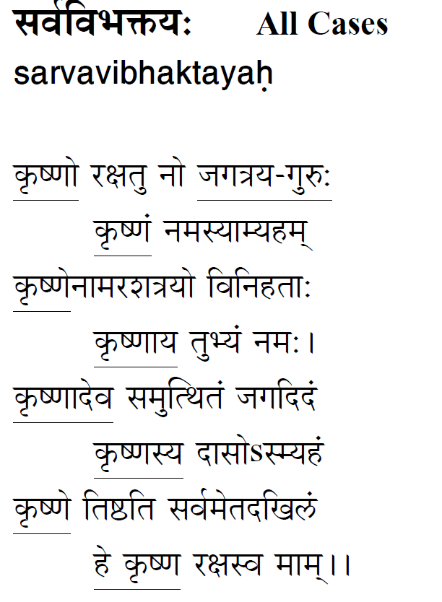

Slide 39
